Slide 1

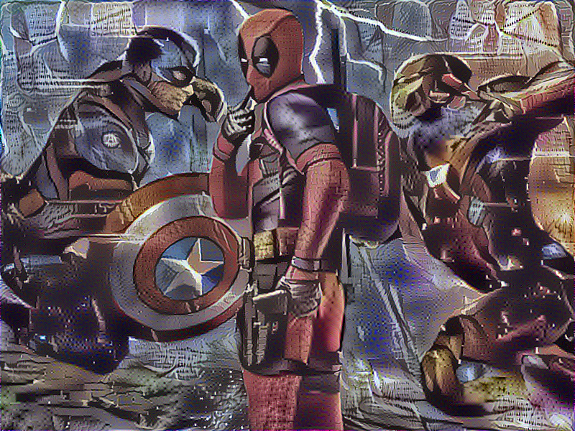
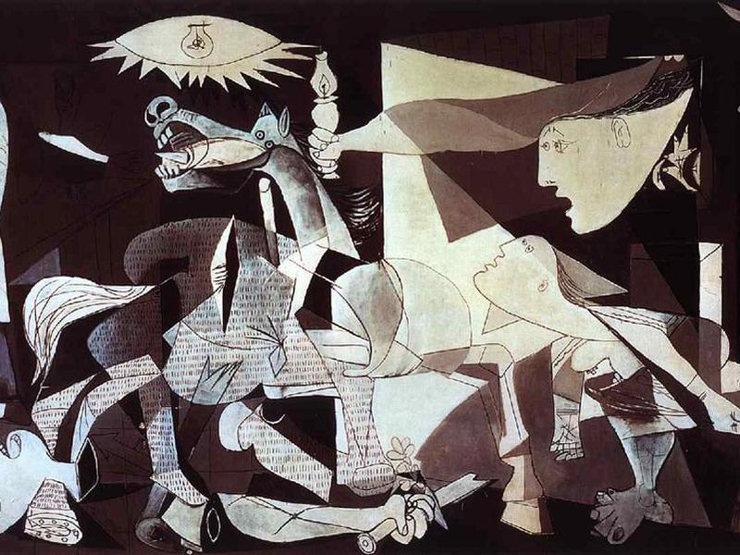
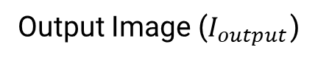
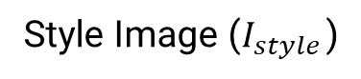
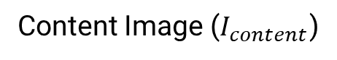
Style Transfer
Content Image ($I_{content}$)
Output Image ($I_{output}$)
Style Image ($I_{style}$)

Slide 2
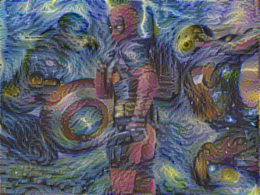
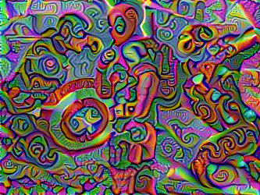

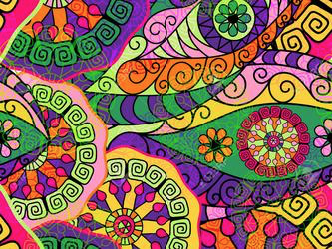
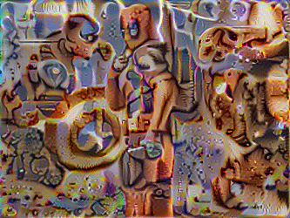
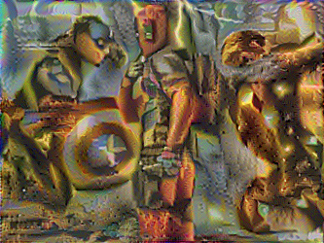
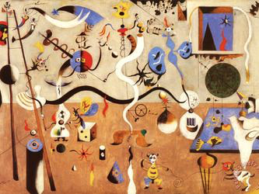
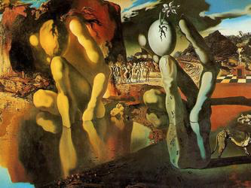
Style Transfer

Slide 3
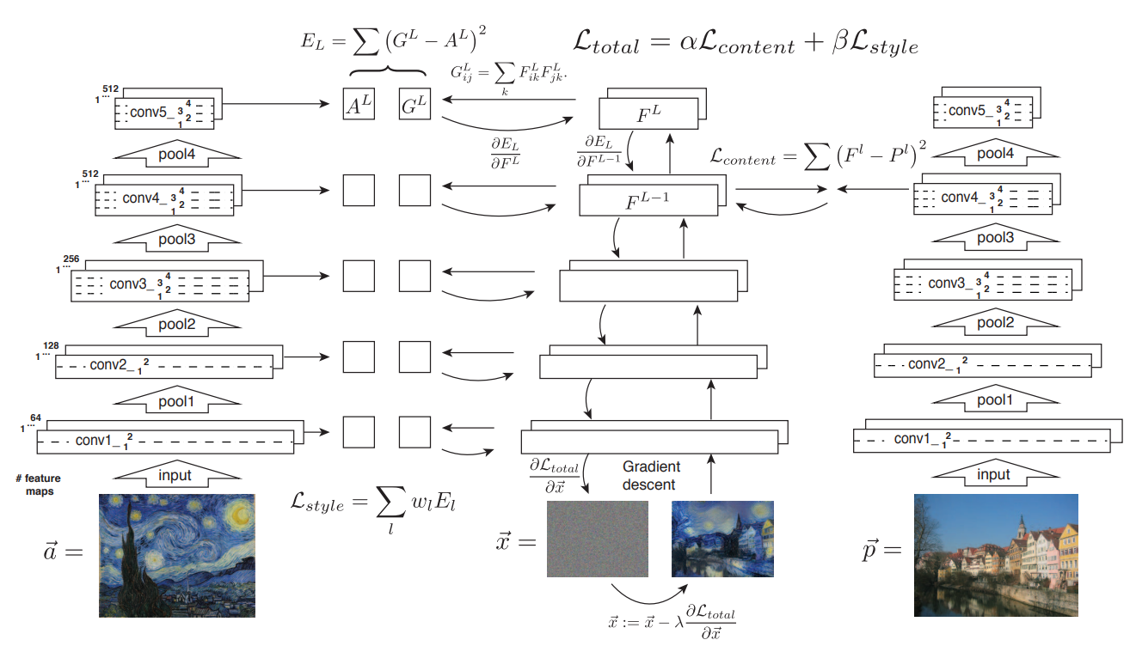
Style Transfer
Style Image
Output Image
Content Image

Slide 4
Style Transfer
1. How to represent content

Slide 5
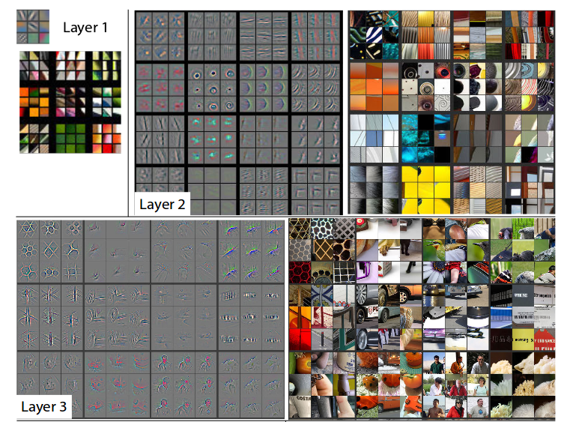
Style Transfer
Content Representation

Slide 6
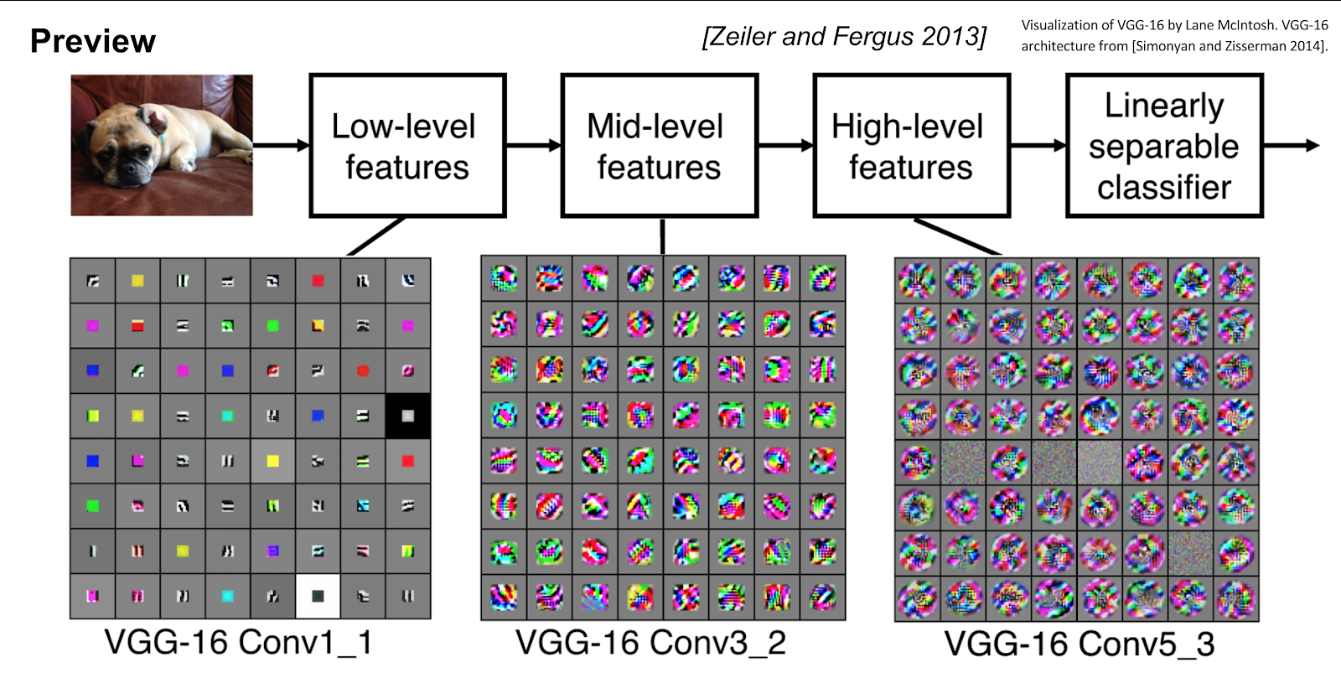
Style Transfer
Content Representation
For “Conv1_1”
1. # of filter:
?
2. size of filter:
? x ?
3. # of feature:
? x ? x ?
5
5

Slide 7
Style Transfer
Content Representation
For “Conv1_1”
1. # of filter:
64
2. size of filter:
? x ?
3. # of feature:
? x ? x ?
5
5

Slide 8
Style Transfer
Content Representation
For “Conv1_1”
1. # of filter:
64
2. size of filter:
5 x 5
3. # of feature:
? x ? x ?
5
5

Slide 9
Style Transfer
Content Representation
For “Conv1_1”
1. # of filter:
64
2. size of filter:
5 x 5
3. # of feature:
64 x 5 x 5
5
5

Slide 10
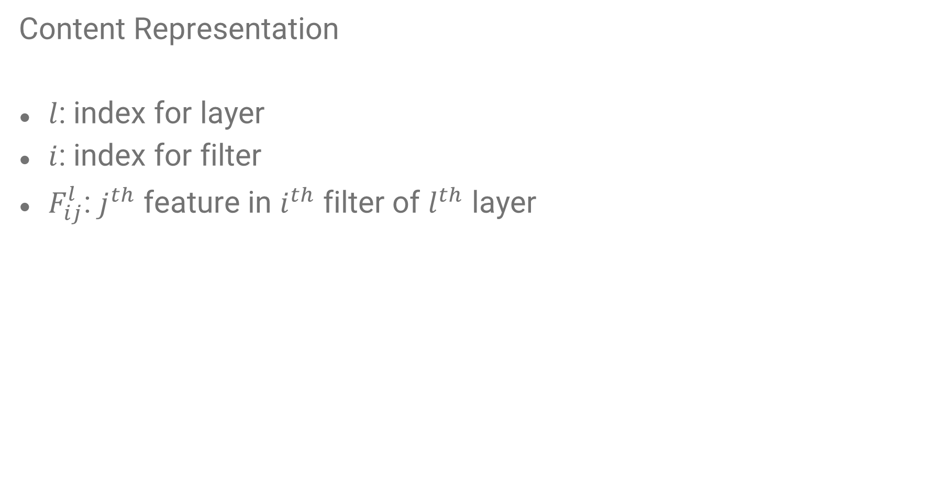
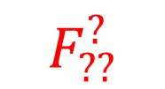
Style Transfer
Content Representation
$l$: index for layer
$i$: index for filter
$F_{ij}^{l}$: $j^{th}$ feature in $i^{th}$ filter of $l^{th}$ layer
3
3
$$F_{??}^{?}$$

Slide 11
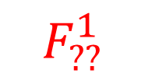
Style Transfer
Content Representation
$l$: index for layer
$i$: index for filter
$F_{ij}^{l}$: $j^{th}$ feature in $i^{th}$ filter of $l^{th}$ layer
3
3
$$F_{??}^{1}$$

Slide 12
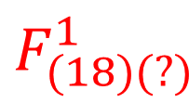
Style Transfer
Content Representation
$l$: index for layer
$i$: index for filter
$F_{ij}^{l}$: $j^{th}$ feature in $i^{th}$ filter of $l^{th}$ layer
3
3
$$F_{(18)(?)}^{1}$$

Slide 13
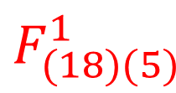
Style Transfer
Content Representation
$l$: index for layer
$i$: index for filter
$F_{ij}^{l}$: $j^{th}$ feature in $i^{th}$ filter of $l^{th}$ layer
3
3
$$F_{(18)(5)}^{1}$$

Slide 14
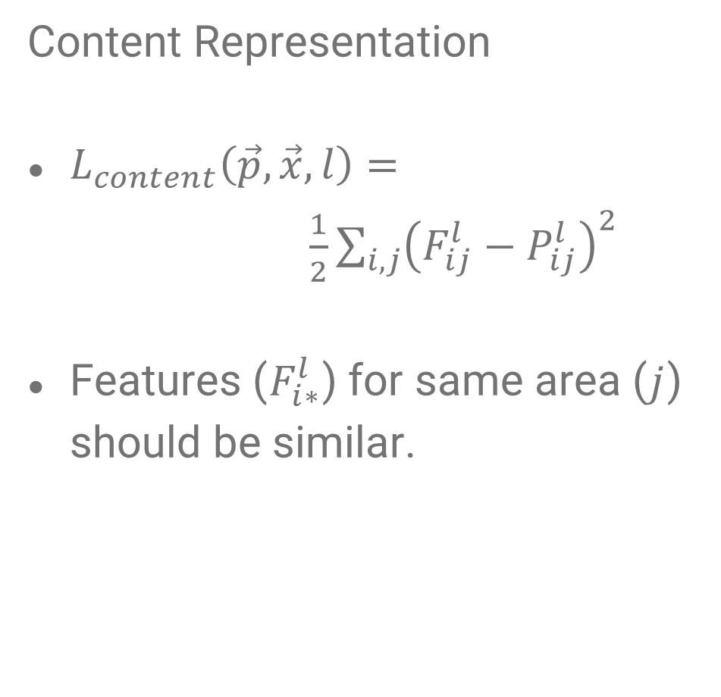


Style Transfer
Content Representation
$L_{content}\left(\vec{p}, \vec{x}, l\right)=$
$\frac{1}{2}\sum_{i,j}{{\left(F_{ij}^{l}−P_{ij}^{l}\right)}^{2}}$
Features ($F_{i∗}^{l}$) for same area ($j$) should be similar.
$$F_{ij}^{l}$$
$$P_{ij}^{l}$$
Output Image
Content Image

Slide 15
Style Transfer
2. How to represent style

Slide 16
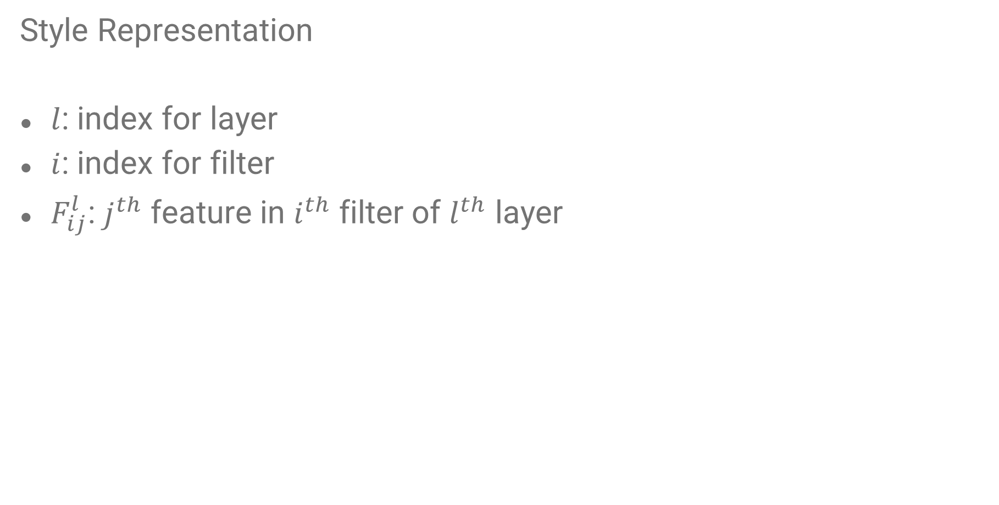
Style Transfer
Style Representation
$l$: index for layer
$i$: index for filter
$F_{ij}^{l}$: $j^{th}$ feature in $i^{th}$ filter of $l^{th}$ layer
3
3
$$F_{(18)(5)}^{1}$$

Slide 17
Style Transfer
1
Style Representation
3
Flatten
3
9

Slide 18
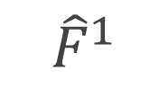
Style Transfer
Style Representation
3
3
64
Flatten
9
$${\hat{F}}^{1}$$

Slide 19
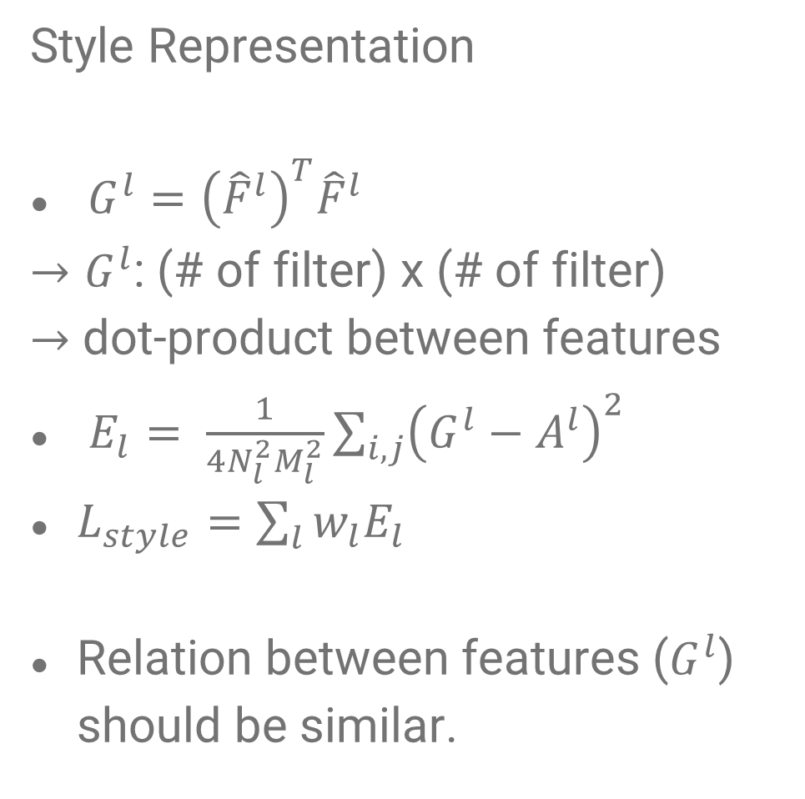
Style Transfer
Style Representation
$G^{l}={\left({\hat{F}}^{l}\right)}^{T}{\hat{F}}^{l}$
$→G^{l}$: (# of filter) x (# of filter)
$→$ dot-product between features
$E_{l}= \frac{1}{4N_{l}^{2}M_{l}^{2}}\sum_{i,j}{{\left(G^{l}−A^{l}\right)}^{2}}$
$L_{style}=\sum_{l}{w_{l}E_{l}}$
Relation between features ($G^{l}$) should be similar.

Slide 20
Style Transfer
3. How to generate image

Slide 21
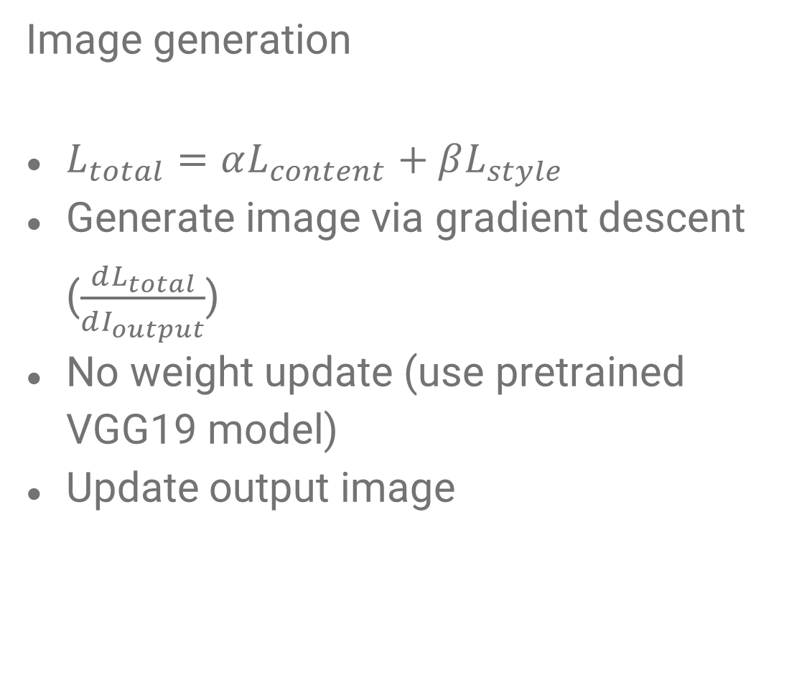
Style Transfer
Image generation
$L_{total}=αL_{content}+βL_{style}$
Generate image via gradient descent ($\frac{dL_{total}}{dI_{output}}$)
No weight update (use pretrained VGG19 model)
Update output image

Slide 22
Reference
[1] Isola, Phillip, et al. "Image-to-image translation with conditional adversarial networks." Proceedings of the IEEE conference on computer vision and pattern recognition. 2017.
[2] https://web.stanford.edu/class/cs20si/2017/index.html
[3] https://github.com/Hvass-Labs/TensorFlow-Tutorials/blob/master/15_Style_Transfer.ipynb

